Slide 1

Introduction to Ethereum

Slide 2
Decentralized Networks
Pros of Decentralized Networks
Don’t have to trust a central authority
No single point of failure
Open to everyone
Strengthen network vitality
Cons of Decentralized Networks
Slow
Expensive
Difficult to scale

Slide 3
Cryptocurrencies
Decentralized Network representing value
Blockchain is the underlying technology for most cryptocurrencies
Decentralized Networks differ by
Protocol
Representation of Value
“The decentralized control of each cryptocurrency works through a blockchain, which is a public transaction database, functioning as a distributed ledger.”

Slide 4
The Blockchain : What’s in a Block?
A Blockchain is an immutable, decentralized ledger
A simple ledger or blockchain can be a singly linked list*
parentHash
number
transactions
accountsState
timestamp
What might be stored in a block

Slide 5
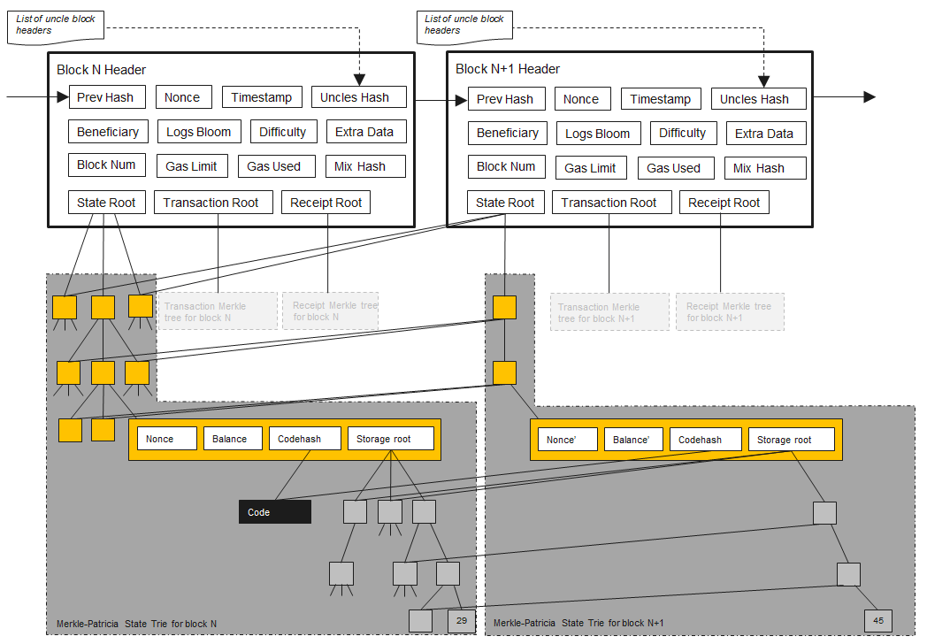

Slide 6
The Blockchain : What’s a Hash?
B_{n}
Deterministic value (hash)
Example:
hash(B_{n}) = 0x5CFF91 (Some green color)
parentHash
number
transactions
accountsState
timestamp
Cryptographic hash function

Slide 7
The Blockchain: Linking the Chain
A block’s hash is some deterministic value given its data in its entirety (header)
A hashing function always produces the same hash if it is given the same input
B₀
B₁
B₂
parentHash = null
parentHash = 0x5CFF91
parentHash = x1556BE
hash(B₀) = 0x5CFF91
hash(B₁) = x1556BE
hash(B₂) = FF4500

Slide 8
The Blockchain: The Chosen One
How do we choose the next canonical block for the chain?
Proof of Work
?
?
?

Slide 9

Network Consensus: Proof of Work
Pros
Proof in precedence
High level of Security
Cons
Resource intensive
Do some long term scenario thinking
on the sustainability of this
Notes:
Pros
Proof in the order that transactions came in and reproducibility
Security is high because youre competing against all of the power on the network
Cons
LOTS OF POWER

Slide 10
Bitcoin’s UTXO Model
Pros
Parallel processing (order doesn’t matter)
Better privacy (different change address)
Cons
Complicated to implement
Statelessness
Notes:
Pros
Parallel Processing
Because you’re spending different UTXOs, the order in which they’re processed doesn’t matter assuming you’re not using a UTXO generated by the transaction
Privacy
You can set the change address to a new public address every transaction, so it makes it more difficult to link accounts together
Cons
Complicated
Have to keep track of all UTXOs owned by a private key, and then determine the correct subset of UTXOs to create the right amount for a transaction
Statelessness
Imposing stateful ideologies onto a stateless object doesn’t really make sense.

Slide 11
Ethereum’s Account Model
Externally Owned Accounts
EOA Accounts have balances
Contract Accounts
Have balances and contract storage
Smart Contracts
Notes:
EOA Accounts are what you and me would have. They’re what the user has.
Contract accounts that don’t have a user per say (they do have owner addresses), but have a balance and EVM bytecode.
What would ETH be without Contract Accounts? It would simply be bitcoin without added benefits of privacy, parallelizability, and UTXO. (NO BENEFIT)

Slide 12
Ethereum Accounts
Pros
Less space required per EOA
Simpler conceptually and in implementation
More fungible
Simpler light clients
Cons
Cannot remove unused accounts
Notes:
Less space - don’t have to maintain details for specific utxos,
Simpler conceptually - It’s literally just addition and subtraction
More Fungible - there’s no distinction between my 5 eth right now, vs if I sold 5 eth and bought 5 more. They’re identical.
Light client reference - light clients only store information about an EOA, scanning the history of the blockchain to get only transactions involving this public address. This makes it much easier to have phone wallets etc instead of having a full node.

Slide 13
Account VS UTXO Pros
UTXO
More private
Potentially more scalable
Accounts
Less Space
Simpler
Fungible
Simpler light clients

Slide 14
Ethereum, EVM, Ether / ETH, ETC
Ethereum
Open blockchain platform (blanket term)
Ethereum Virtual Machine (EVM)
Stateful ledger
Smart Contracts
Nodes (can mine but doesn’t have to)
Ether / ETH
The cryptocurrency component
Ethereum Classic / ETC
Fork of Ethereum

Slide 15
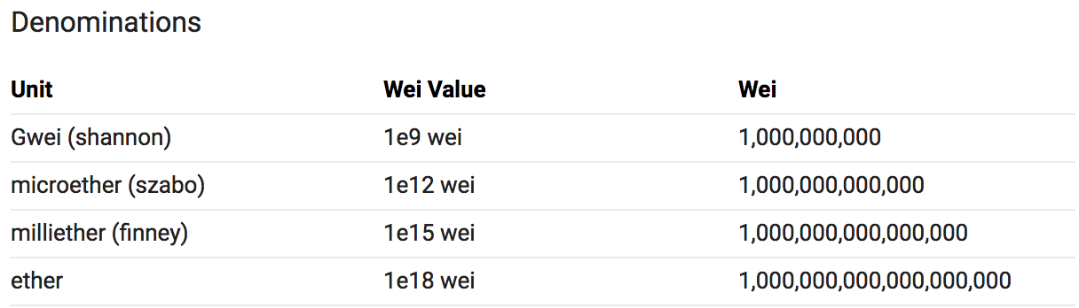
Ether
Limited Supply?
Not exactly, but kind of

Slide 16
EVM
Smart Contracts
Populated in Contract Accounts
Contains EVM Bytecode
Has an address
Has a balance
Solidity
The language of smart contracts
Statically typed
Compiles to EVM Bytecode

Slide 17

Who Has The Blockchain? (Nodes)
Not Miners
Full Nodes
Run and verify every block since genesis
Light Nodes
Only keep track of/run transactions pertaining to specific accounts
Miners
Full Node, plus mining software
CPU or GPU mining
Geth for CPU
Ethminer, Claymore etc. for GPU

Slide 18

Gas
Currency used to pay for processing Smart Contracts on the blockchain
It costs gas to store and compute on the blockchain
This is expensive since everyone has to do it
Storing is more expensive that performing computations (Arithmetic, conditional)
Good DAPP Practices
Make your smart contracts simple to
conserve on gas
Do all computations that don’t need the
features of blockchain, off-chain

Slide 19
Networks
Public
Production
Mainnet
Test
Ropsten
Rinkeby
Kovan
Private
You can launch your own Ethereum blockchain!

Slide 20
DApps
Web3.js
Javascript library to interact with the Ethereum blockchain
Need a light client (like MetaMask) to send transactions
Why do we need Web3.js?
Contract account methods need to be externally called

